Slide 1
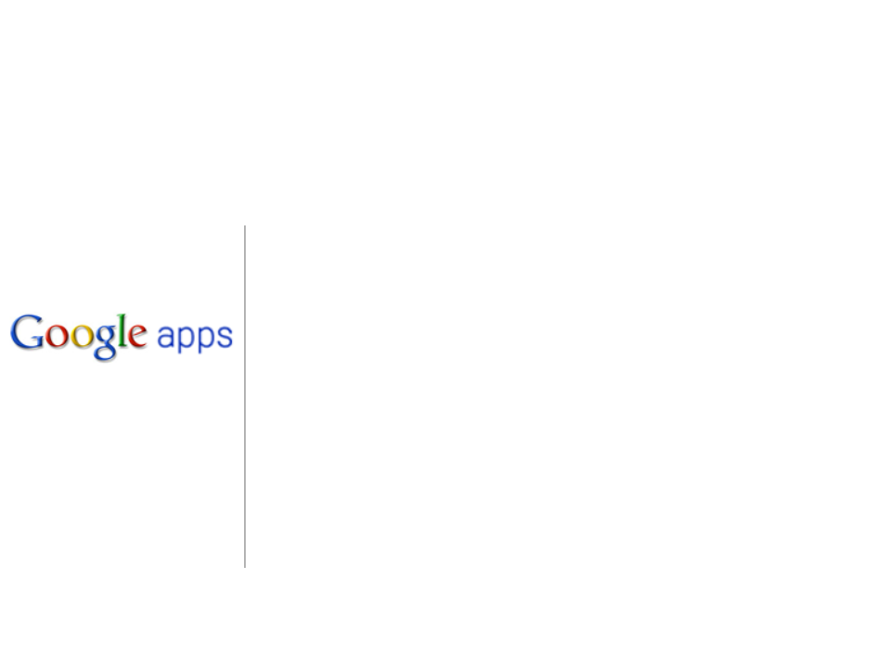
What’s New in Google Apps
June 2012

Slide 2
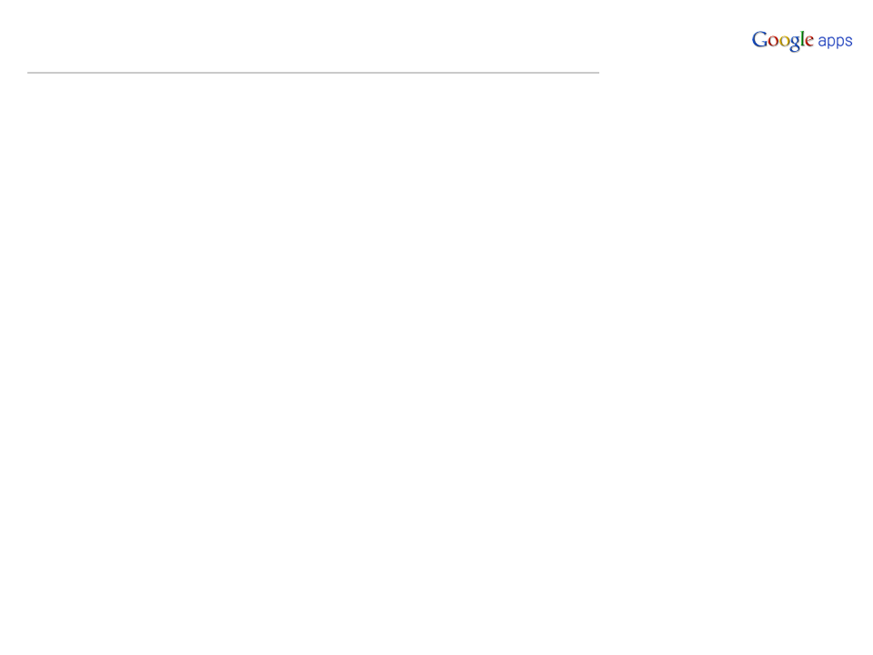
Agenda
Google Apps Control Panel Enhancements
Google Mail Enhancements
Docs and Drive Updates
Mobile Updates
Tools and Connectors
Partner Corner: Partner-specifics

Slide 3
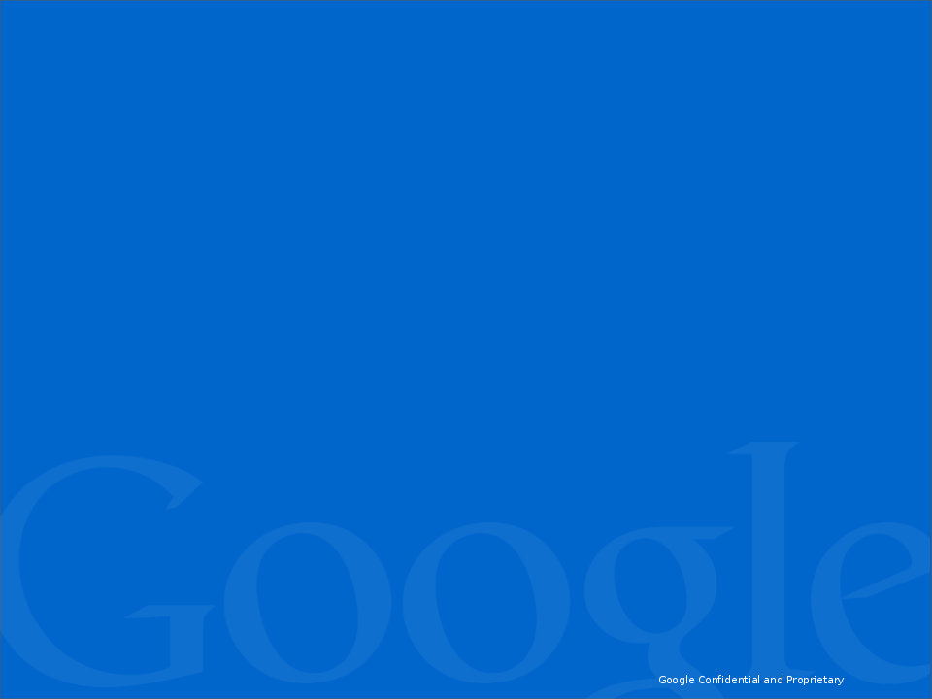
Google Apps Control Panel
Enhancements

Slide 4
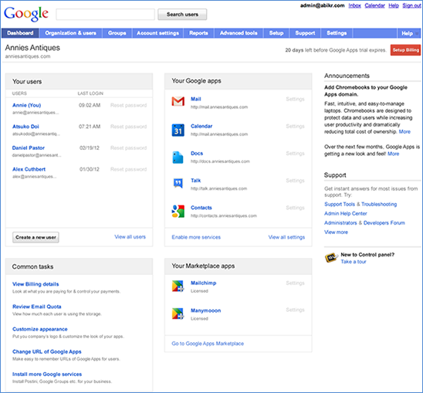
ReminderNew Control Panel Dashboard User Interface
http://googleappsupdates.blogspot.com/2012/04/new-google-apps-control-panel-dashboard.html
New Control panel dashboard rolling out across all domains
Simplified dashboard layout
Brings commonly used actions and setup tasks to main page
Available Editions:
Google Apps for Business
US English only
Education and Government
Late-May to early-June

Slide 5
June 6th: Permanent move to IP version 6
http://googleappsupdates.blogspot.co.uk/2012/05/ipv6-will-be-permanently-enabled-on.htmlhttp://ipv4.google.com/support/websearch/bin/answer.py?answer=1299266&topic=8995&hl=en
A reminder that Google will enable IPv6 permanently on June 6th, 2012
The countdown to IPv6 was announced back on January 17th, 2012 here
This was done for 24 hours a year ago and we did not notice any major disruptions for Apps customers
What is IPv6?
Internet Protocol version 6 (IPv6) is the new version of the Internet Protocol
The addresses used by the current version of the Internet Protocol, IPv4, are nearly all used
The launch of IPv6 will enable future innovation and growth for the Internet
NOTE: Customers with SSO IP Whitelists and IPv6 capable equipment need to ensure that their SSO whitelist configuration contains their IPv6 network segments (if applicable)
Read our SSO Help Center article
Notes:
At Google, we believe that IPv6 is essential to the continued health and openness of the Internet – and that by allowing all devices to talk to each other directly, t

Slide 6
Google Mail Enhancements

Slide 7
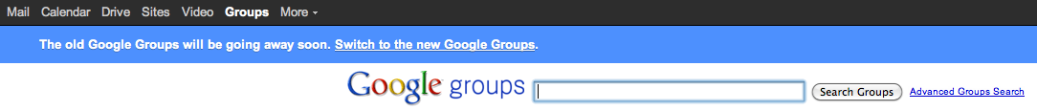
Google Groups Redesign
Update Alert: http://googleappsupdates.blogspot.co.uk/2012/05/google-groups-redesign.html
Completely redesigned from the ground up! The new Google Groups now comes with...
a new and improved user interface
collaborative inbox
take and assign topic functionality
multi-domain support
advanced search operators
new ways of viewing group content
and much more!
How to access what's new
Beginning May 15, Rapid Release users who navigate to the Google Groups page will see a horizontal blue bar toward the top of the groups page:
Scheduled Release users who navigate to the Google Groups page will simply see a notification that Groups will be changing soon.

Slide 8
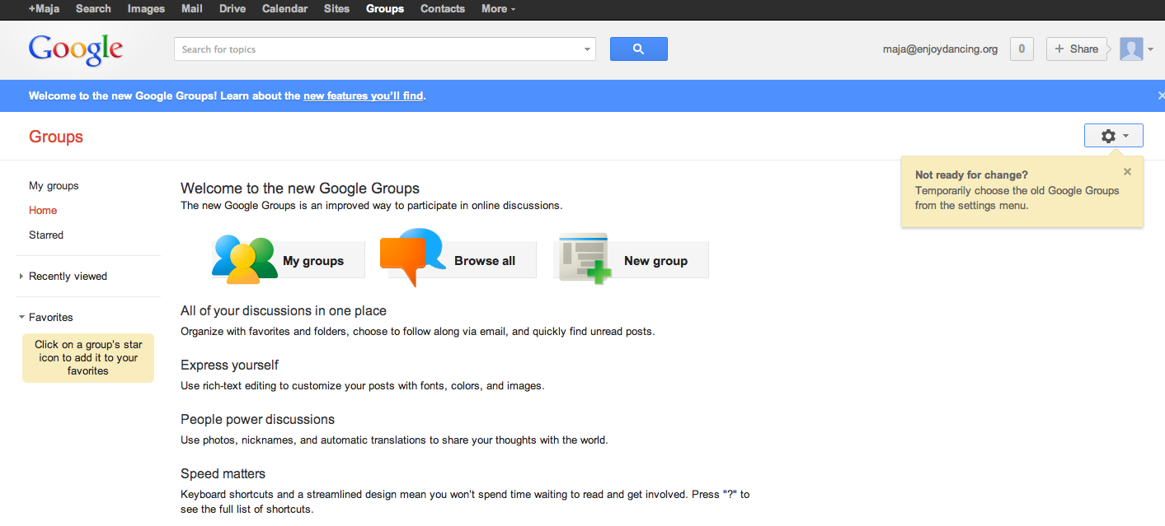
Google Groups Redesign - continued
LIVE DEMO
For more resources and a visual tour, see our Help Center on the New Google Groups!

Slide 9
Various Gmail Updates - Highlights
New features
Automatically translate messages, Title tweaks, Smart Mute, and some labs retirements
Gmail now has the following new features:
Automatic language translation
The text in the browser tab now reads "Inbox (20) - user@example.com - Gmail" instead of "Gmail - Inbox (20) - user@example.com”
A change to the way "Mute" worksGraduation of the lab "Nav bar drag and drop" lab, which allows the user to reorder gadgets inside the gadget pane
Languages
Gmail is now available in Welsh and Latin American Spanish
End-users can now select Welsh and Latin American Spanish as the default language in Gmail
Google+
Quick access to contact details, improved autocomplete and Google+ circle integrations
Start a chat, call their phone and more when you search for a contact
Improved autocomplete predictions based on the content in your email

Slide 10
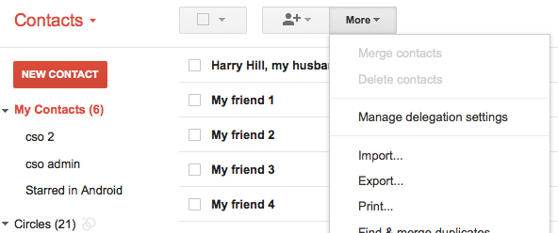
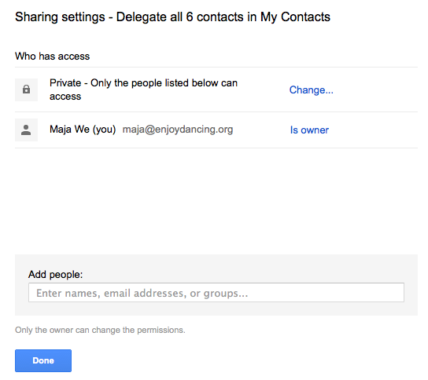
ReminderContacts Delegation
Update Alert: http://googleappsupdates.blogspot.com/2012/04/new-feature-contacts-delegation.html
Help Center: http://support.google.com/a/bin/answer.py?hl=en&topic=20016&answer=2590392
Enterprise Blog: http://googleenterprise.blogspot.com/2012/05/new-ways-to-share-and-manage-your.html
You can delegate access to your "My contacts"
Previously, you could delegate access to Gmail & your contacts together, but not separately
How to access what's new: In Contacts, under "More", click "Manage delegation settings"

Slide 11
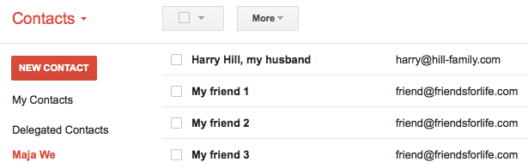
ReminderContacts Delegation - continued
Update Alert: http://googleappsupdates.blogspot.com/2012/04/new-feature-contacts-delegation.html
Help Center: http://support.google.com/a/bin/answer.py?hl=en&topic=20016&answer=2590392
NEW! You can delegate access to your "My contacts"
Previously, you could delegate access to Gmail & your contacts together, but not separately
A delegatee will see delegated contacts of other users under "Delegated Contacts" > "[Name of user who granted you access]"
This is how the delegated contacts appear for the delegatee:

Slide 12
New Google Bar: Rollout to All Domains on June 11th
Update Alert: http://googleappsupdates.blogspot.co.uk/2012/06/google-bar-update-rolling-out-monday.html
From Monday June 11th, the New Google bar look will be rolling out to all Google Apps users
The new Google bar has links to core services at the top level and a More drop-down list with links to additional services
NOTE: Google Search, Images and Mobile always appear in the Google bar
When you turn off a service, other services move to the top level of the Google bar or to a higher position in the list of services under 'More'
Editions included: Google Apps, Google Apps for Business, Government and Education
Languages included: All languages supported
Additional Help Center References:
http://support.google.com/a/bin/answer.py?hl=en&answer=2561767
http://support.google.com/accounts/bin/answer.py?hl=en&answer=1714464

Slide 13
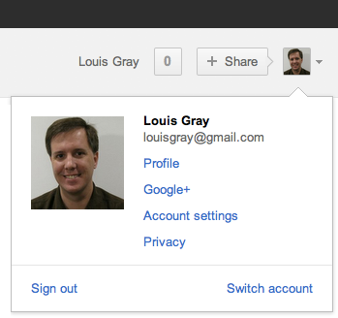
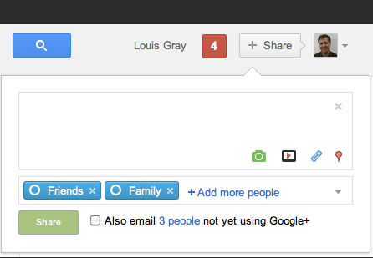
ReminderNew Google Bar
Top navigation bar is now more consistent, providing streamlined user experience and increased visibility of the most popular services
http://googleappsupdates.blogspot.com/2012/04/google-bar-update-rolling-out-monday.html
http://support.google.com/accounts/bin/answer.py?hl=en&answer=1714464
Access your profile and account settings
Share directly with Google+ circles

Slide 14
Docs and Drive Updates

Slide 15
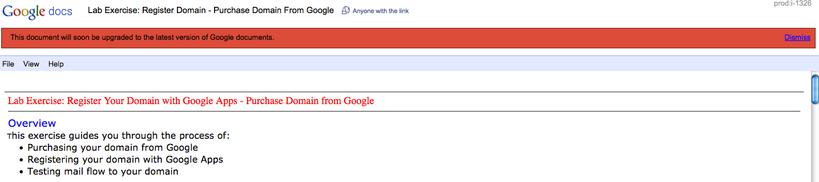
Google Docs' New Editor: Migration starting May 16th
Update Alert:
http://googleappsupdates.blogspot.com/2012/05/new-version-of-google-documents-rolling.html
Any legacy Google Documents (Those created before July 2010) will be transitioned to the new document editor
The new Google Docs editor has the following features:
Real time collaboration - See updates from other collaborators as they edit the document
Higher-quality imports - More consistent imports from your desktop into Google Docs
Ruler - Google documents have a ruler for setting margins, indentations, and tab stops
Chat with other collaborators - As you make your edits, you can chat with other document editors about the changes, from within the document
See an example of a legacy document below - these documents will show a notification "This document will soon be upgraded to the latest version of Google documents":

Slide 16
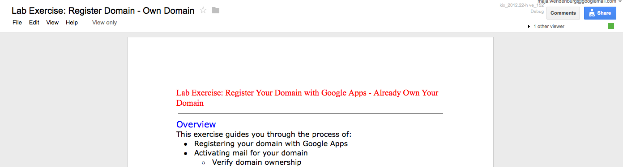
Google Docs' New Editor: Migration starting May 16th - continued
This is what the new Google Docs editor looks like:
Release tracks: Rapid & Scheduled
Editions included: Google Apps, Google Apps for Business, Government and Education
Languages included: All languages supported
Additional Help Center Links:https://support.google.com/docs/bin/answer.py?hl=en&answer=176442
http://support.google.com/docs/bin/answer.py?hl=en&answer=2398701
http://support.google.com/docs/bin/answer.py?hl=en&answer=183813

Slide 17
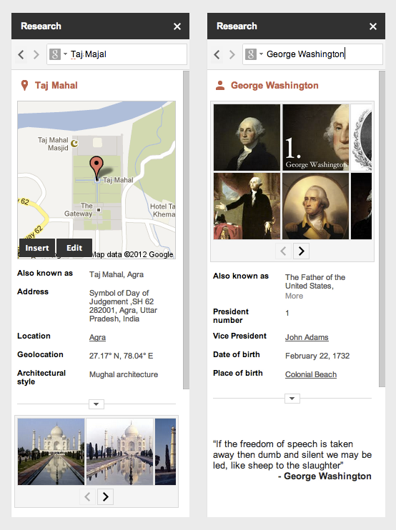
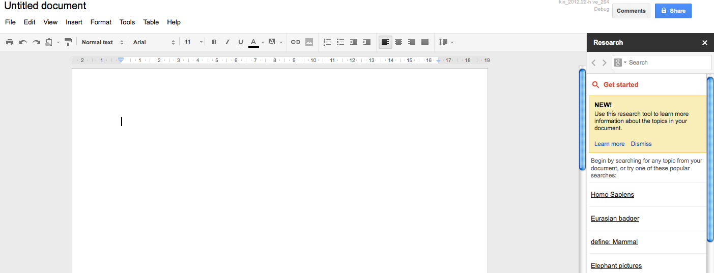
New in Google Docs: Research Pane
Find facts and do research from inside Google Docs
http://googledocs.blogspot.co.uk/2012/05/find-facts-and-do-research-inside.html
Directly search on Google Search from Google documents
You don’t even have to open a new tab
You can access the research pane from the Tools menu: Right clicking on a selected word that you want to learn more about
Or press Ctrl+Alt+R on Windows, or Cmd+Alt+R on Mac
From the research pane, you can search for whatever info you need: Look up maps, quotes, images, and much more
Available for Rapid Release Track

Slide 18
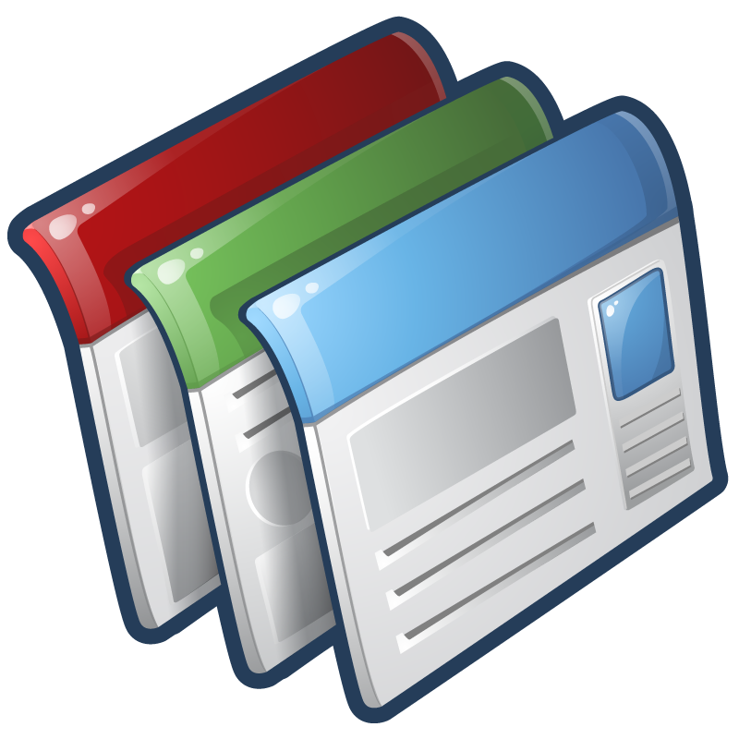
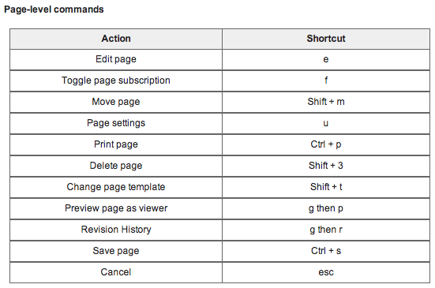
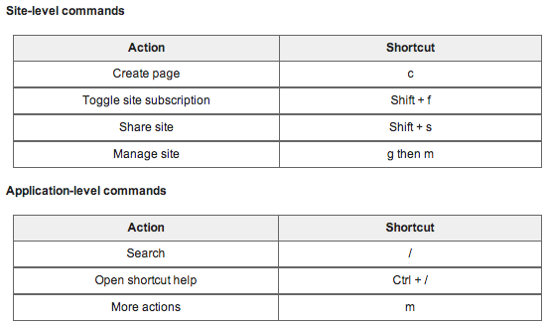
Google Sites: Keyboard Shortcuts in Sites editor
Help Center: http://support.google.com/sites/bin/answer.py?hl=en&answer=189191
Google Sites now includes keyboard shortcuts that allow you to do many tasks without using the mouse:

Slide 19
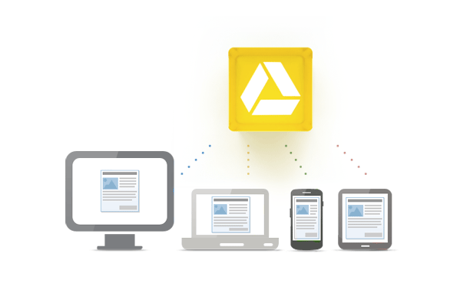
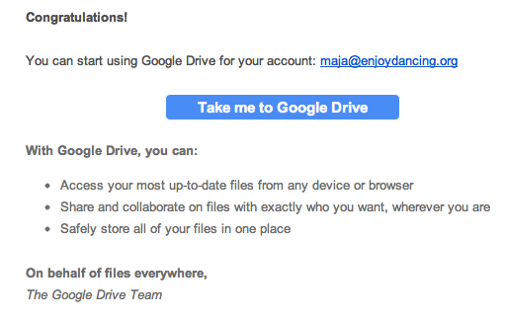
Google Drive Roll Out
Rolling Out to all domains in 2 phases:
First Phase: Opt-In only
Second Phase: Opt-Out only
For more details, see our Google Drive Transition notes
Welcoming for End Users
Once a user has transitioned to Google Drive, they will receive this welcome message:

Slide 20
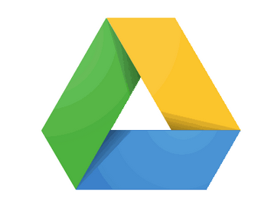
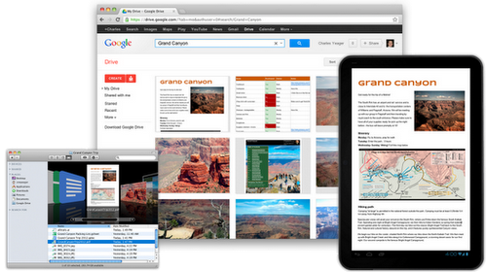
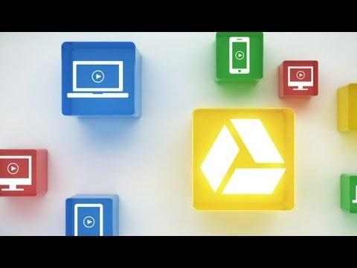
ReminderNew Product: Google Drive
Sync files between all of your devices: Mac, PC, mobile, browser
Update Alert: http://googleappsupdates.blogspot.com/2012/04/new-product-google-drive.html
Enterprise Blog: http://googleenterprise.blogspot.com/2012/04/introducing-google-drive-newest-member.html
- Files can be accessed via Browser, Google Drive Client or Google Drive Mobile App
- Free storage of 5 GB per user
- Additional storage can be purchased
- Rolling out to all domains started
Google Drive: What's New
Create and collaborate
Store everything safely and access it anywhere (especially while on the go)
Search everything
Watch the Video "Go Google: Google Drive"
Notes:
Drive is built to work seamlessly with your overall Google experience. You can attach photos from Drive to posts in Google+, and soon you’ll be able to attach stuff from Drive directly to emails in Gmail. Drive is also an open platform, so we’re working with many third-party developers so you can do things like send faxes, edit videos and create website mockups directly from Drive. To install these apps, visit the Chrome Web Store—and look out for even more useful apps in the future.
This is just the beginning for Google Drive; there’s a lot more to come.

Slide 21
Mobile Update

Slide 22
Android: New version of Google Apps Device Policy
http://googleappsupdates.blogspot.co.uk/2012/05/new-version-of-google-apps-device.html
Version 4.05 of Google Apps Device Policy is now available for Android users
Now with Multiple Account support: Google Apps Device Policy app allows users to register with multiple Google Apps domains
New supported settings for Android in the Google Apps control panel Settings > Mobile >Org Settings:
Number of days before password expires for Android 3.0+
Number of expired passwords that are blocked for Android 3.0+
Allow/block camera for Android 4.0+
NOTE: If a Google Apps domain is enforcing policies that are not supported by a user’s Android device, the affected users will be blocked from accessing their accounts. Learn more about enforcing device policies
How to access what's new:
Download Device Policy on Google Play

Slide 23
Tools and Connectors

Slide 24
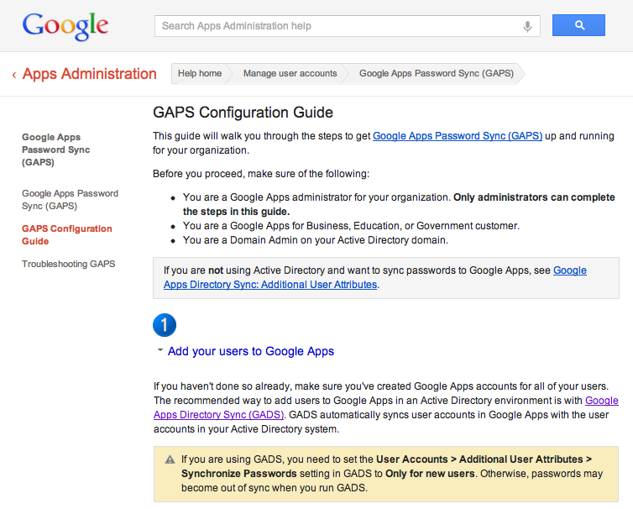
New! Google Apps Password Sync (GAPS) for Active Directory
Update Alert: http://googleappsupdates.blogspot.co.uk/2012/05/new-product-google-apps-password-sync.html
GAPS allows admins to synchronize their users' passwords from Active Directory (AD) to Google Apps as they are changed
What is GAPS?
Tool to sync passwords into Google Apps
Only works from Active Directory into Google Apps
Only syncs passwords
Does not create users or update other information
Syncs on-the-fly:
No scheduling required
Syncs only a password when it changes - not all passwords
How it works: When the user changes AD password >
GAPS gets the raw password > hashes it as SHA1 >
and sends it to Google Apps using the Provisioning API

Slide 25
- continued Google Apps Password Sync (GAPS) for Active Directory
Download Page
Configuration Guide
What’s new:
- Sync passwords as they are changed - no need to wait for a scheduled sync
- Secure - passwords aren't saved anywhere except on your Active Directory
and Google Apps, and are transmitted hashed and encrypted
- Quick to set up - installation takes only a few minutes per server
Configuration Steps
Add users to Google Apps
Enable Provisioning API
Install and configure GAPS on your writable AD servers
Prevent users from changing their Google Apps passwords directly
Instruct users to change their Active Directory passwords
Editions included: Google Apps for Business, Government and Education
Languages included: English

Slide 26
- continued Google Apps Password Sync (GAPS) for Active Directory
Now... what's different between GADS and GAPS?
Let's have a quick look and compare the functionality of GADS versus GAPS:
Google Apps Directory Sync (GADS) Syncs users, groups... Syncs from any LDAP Scheduled or manual sync Generic password hashes Creates users on GA | Google Apps Password Sync (GAPS) Syncs only passwords Active Directory only Automatic sync on change Active Directory only Doesn't create users

Slide 27
- continued Google Apps Password Sync (GAPS) for Active Directory
So if I decide to use GAPS, what do I do with GADS?
In GADS, disable password sync by choosing Only for new usersand nothing else under User Password Sync
This way GADS will set passwords for new users only
New users on Google Apps will always need a password set
If you used sha1hexfltr or HashingPasswordFilter, you will no longer need them
Then, keep GADS configured to sync as usual

Slide 28
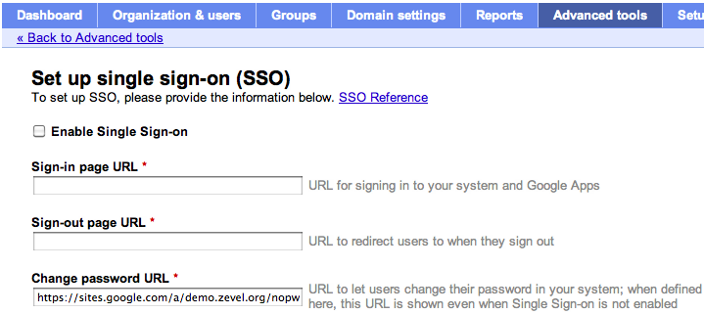
- continued Google Apps Password Sync (GAPS) for Active Directory
Ensure you set a Change password URL in Google Apps Control Panel:
With GAPS you keep Active Directory as the single point of truth for the password
Password changes need to happen in Active Directory (AD)
Password in Google Apps will be overwritten by the password stored in AD
To avoid confusion:
Because if a users changes the Password in Google Apps, this change will not be replicated into Active Directory

Slide 29
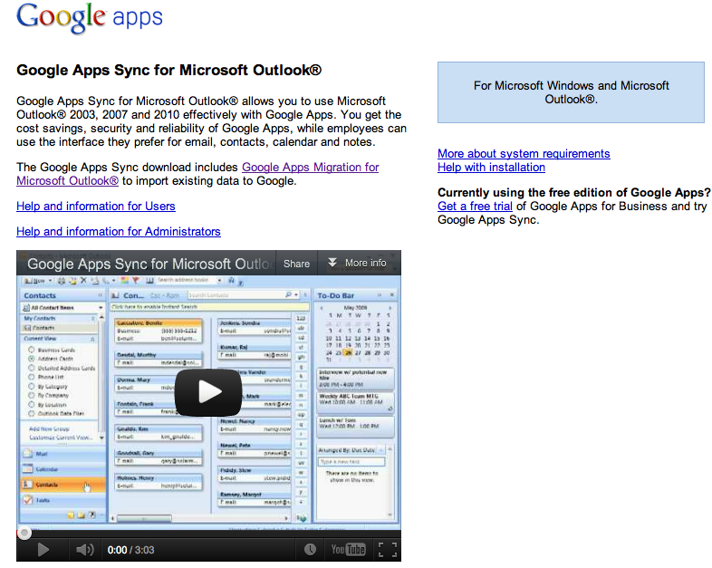
Update: Google Apps Sync for Microsoft Outlook v3.1
Download and Documentation Site: https://tools.google.com/dlpage/gappssync

Slide 30
Update: Google Apps Sync for Microsoft Outlook v3.1 - continued
Help Center: http://support.google.com/a/bin/answer.py?hl=en&answer=153463
Download and Documentation Site: https://tools.google.com/dlpage/gappssync
Version 3.1 of Google Apps Sync for Microsoft Outlook® (GASMO) is rolling out over the next 2-3 weeks with the following new features:
New registry key for hiding the Synchronization Status dialog for new users
Disabled services are now indicated in the Synchronization Status
"Error reported" fix
Editions included: Google Apps for Business, Government and Education
Languages included: US English Only
How to access what's new:
1. Update Google Apps Sync
- If you installed Google App Sync: Updates are checked for and downloaded to your computer automatically.
- If your administrator installed Google Apps Sync: Updates are downloaded to your computer automatically, if your administrator enables automatic updates.
You can also download the latest version at any time from the Google Apps Sync download page.
2. For the update to go into effect:
If you have Windows XP: Restart your computer.
If you have Windows Vista: Restart Microsoft Outlook®.

Slide 31
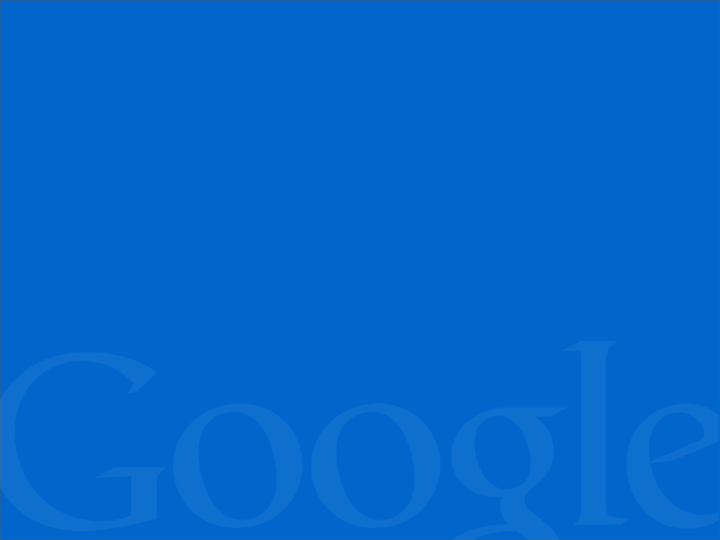
Stay Informed

Slide 32
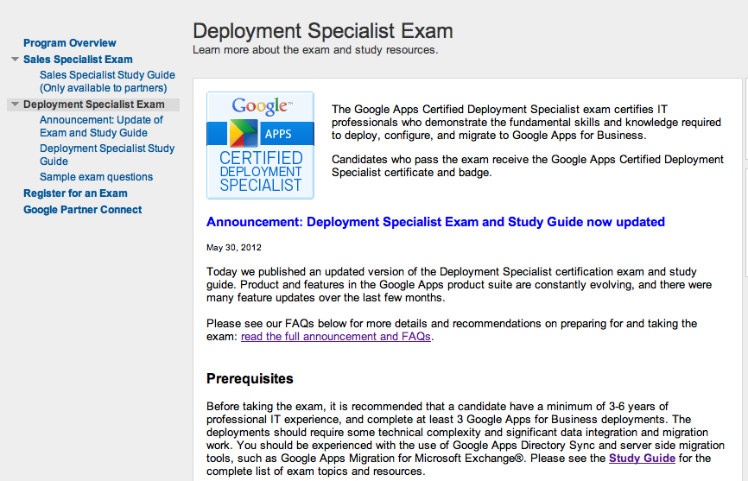
Google Apps Deployment Certification Updated
http://certification.googleapps.com
We have published an updated version of the Deployment Specialist certification exam and study guide: As product and features in the Google Apps product suite are constantly evolving, there were many feature updates over the last few months. These are now incorporated in the new version of the Deployment Specialist certification exam
Check out our new study guide
On the exam update: See our FAQs for more

Slide 33
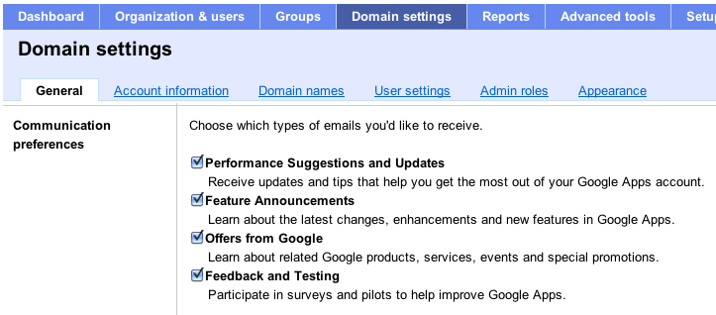
Subscribe to Our Monthly Admin Newsletter
Quick bits of information for Google Apps admins, such as...
High level announcements
Product Q&A Corner: product visions, how customers are using Apps, and other content that connects real-life and people
Tips & Tricks: Features for admins, and tips they can share with their users
To subscribe: Go to "Domain Settings" >
"General" > "Communication preferences"
Check "Performance Suggestions and Updates"
Check past newsletter issues on our Admin Newsletter Archive
Notes:
to click through
so you learn more
and can take action!

Slide 34
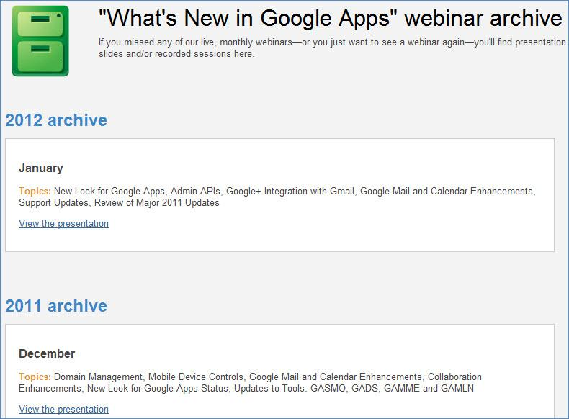
What's New Webinar - Archive
For past webinars, check our Webinar Archive:
http://whatsnew.googleapps.com/whatsnew-webinars-archive

Slide 35
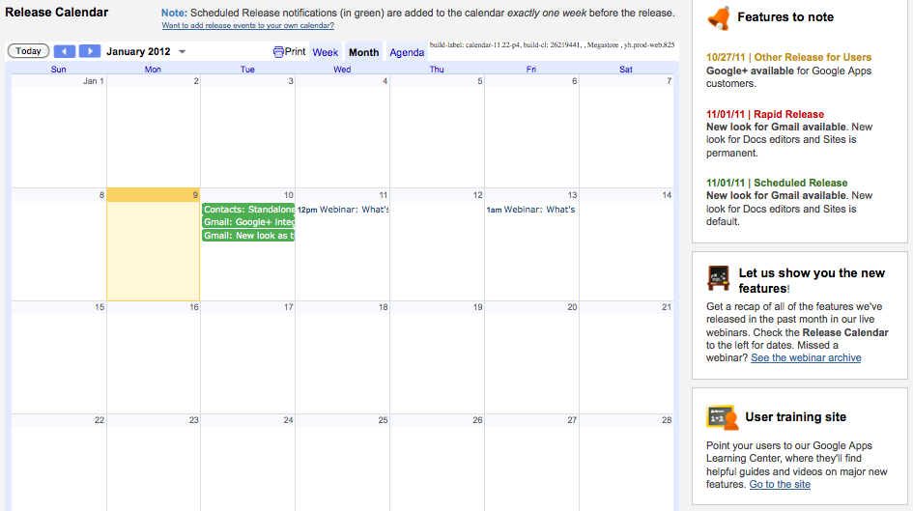
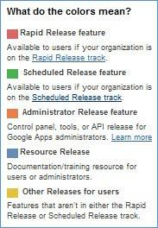
Release Calendar - What's New in Google Apps
http://whatsnew.googleapps.com/

Slide 36
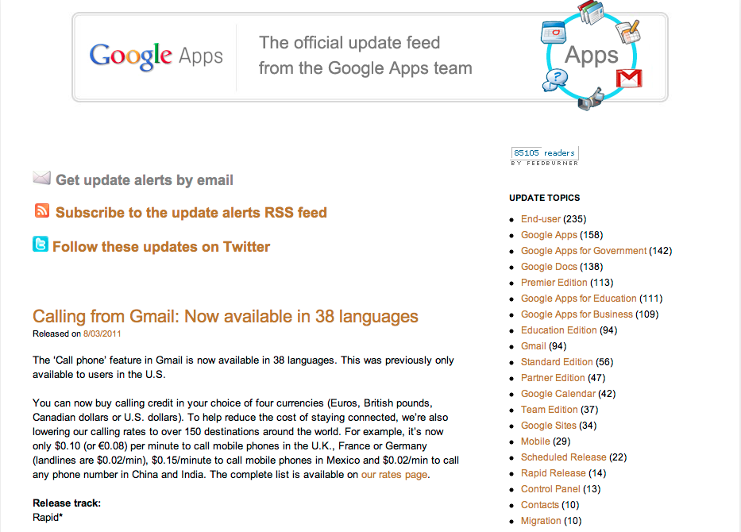
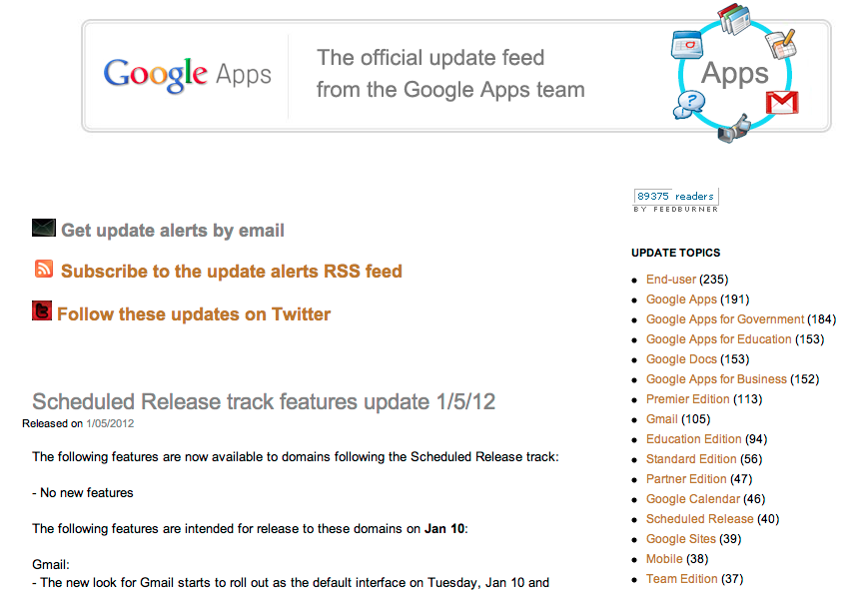
Subscribe to Google Apps Updates
http://googleappsupdates.blogspot.com/

Slide 37
Partner Corner: Let's talk about what's important for you as a Google Enterprise Partner

Slide 38
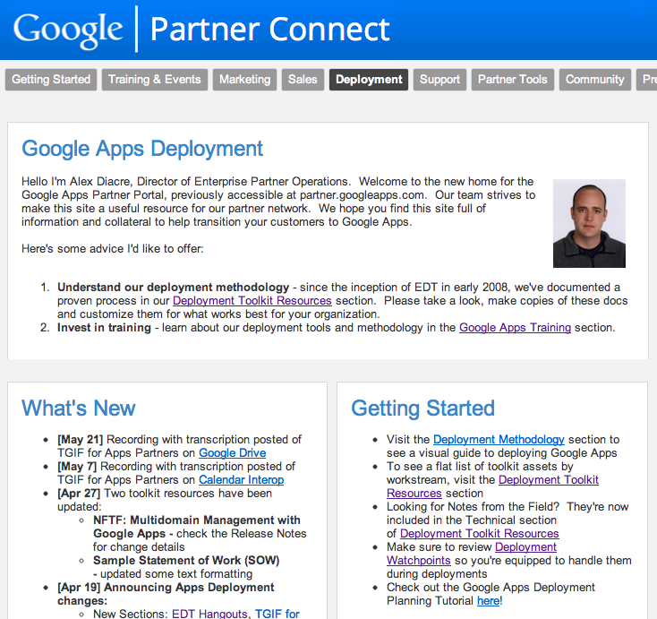
On GPC: Deployment > Apps > What's New:
https://sites.google.com/a/googlepartnerconnect.com/gpc/deployment/apps
Recording with transcription of TGIF for Apps Partners on Google Drive
Recording with transcription of TGIF for Apps Partners on Calendar Interop

Slide 39
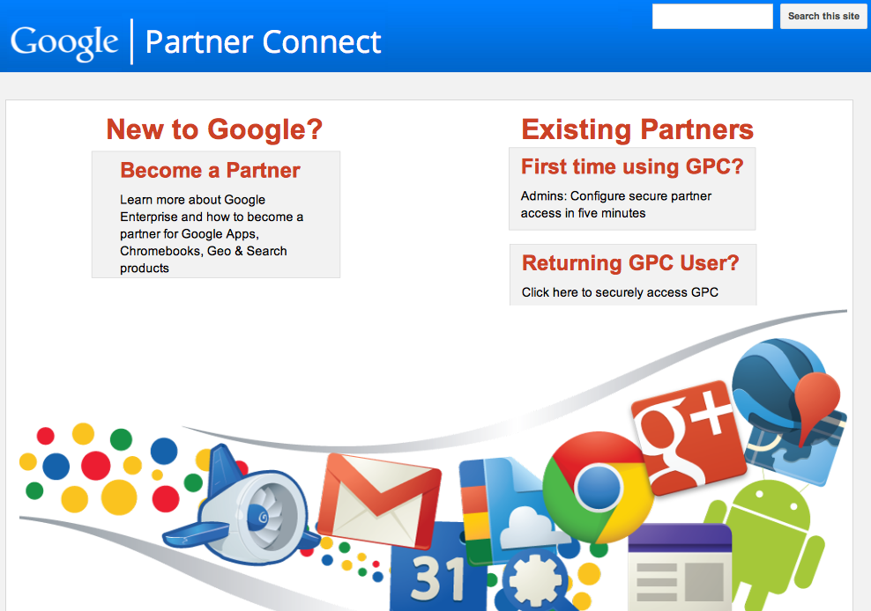
Google Partner Connect (GPC): One-stop-shop for our partners!
http://googlepartnerconnect.com

Slide 40
Thank You

